Slide 1
BOARDING PASS
FLIGHT
AIRLINE DELAYS
B345
GATE
D8
SEAT
29E
TEAM:
Ashley, Gopi, Kiena, Tracy, Zainab

Slide 2
Project Overview
25%- 30%
$28B
DELAYS
COST
Every year, approximately 25-30% of flights are delayed
Delays in flights cost passengers and the operations approximately more than $28 billion
Notes:
In the present world the major components of a transportation system include a passenger airline. With time, we have evolved and improved the airline transportation system and operations. However, even in today's day and time, flight delays cause a lot of inconvenience to our modern passengers. Every year approximately 25-30% of flights are delayed, costing passengers and the operations approximately more than $28 billion in money and their time.

Slide 3
Purpose
03
01
04
02
05
Will flying time impact delay occurrences?
Which airline has the most delayed flights?
Which date of the week will have the most delay? Weekend vs Weekday
Which routes have the most delayed occurrences?
Which airport (departure/arrival) is the worst?
Notes:
The purpose of this project is to predict whether a given flight will be delayed, given the information of the scheduled departure.

Slide 4
BOARDING PASS
FLIGHT
Problem Statement
B345
GATE
NOTE:
D8
SEAT
29E
Predicting Flight Delays
Identify Key Factors causing Delay
Notes:
By conducting an analysis of flight times and metrics regarding airlines, day of travel, and airport arrivals/ departures we can predict what flights are more likely to experience delays. Once patterns are identified, solutions can be developed to address the issues.

Slide 5
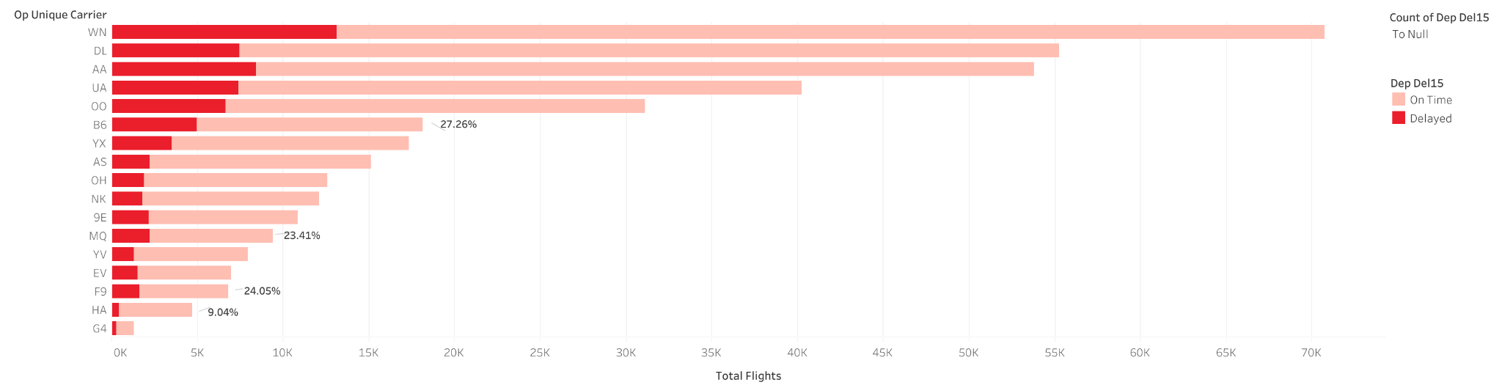
Percentage of Delayed Flights by Airline
Notes:
Summary Results of Delayed Flights by Airline
The top 3 airlines with the highest percentage of delayed flights to total flights are: JetBlue (B6), Frontier Airlines (F9) and Envoy Air (MQ).
The airline with the lowest percentage of delayed flights to total flights is Hawaiian Airlines (HA).
The majority of the listed airlines has a percentage of delayed flights that falls in between 14% and 21%.

Slide 6
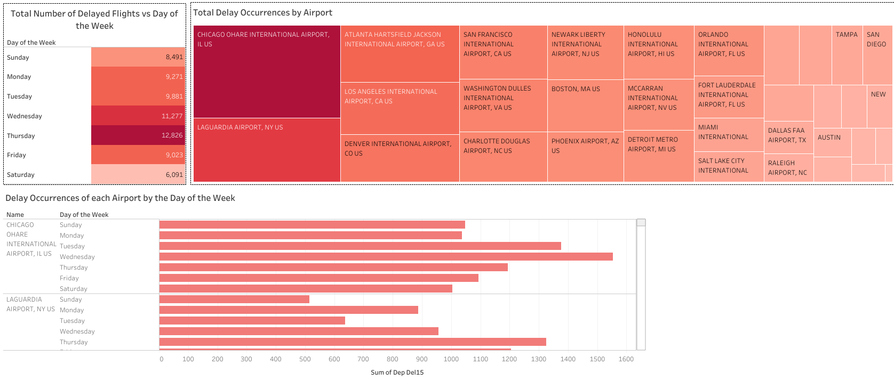

Flight Delays by Day of the Week and Airport
Notes:
Overall, the busiest airports and busiest weekdays have the most amount of delayed flights. Thursday has the most amount of flights of the week as well as the most amount of delayed flights. Saturday has the least amount of total flights as well as the least amount of delayed flights. The majority of delayed flights occurred during the weekdays.
The Chicago O'Hare airport had the most overall flight delays and had the second most flights in total. Atlanta Hartfield Jackson had the most flights of all the listed airports and had the third most flight delays. Minneapolis St. Paul airport had the least amount of flights and flight delays of all the listed airports.

Slide 7
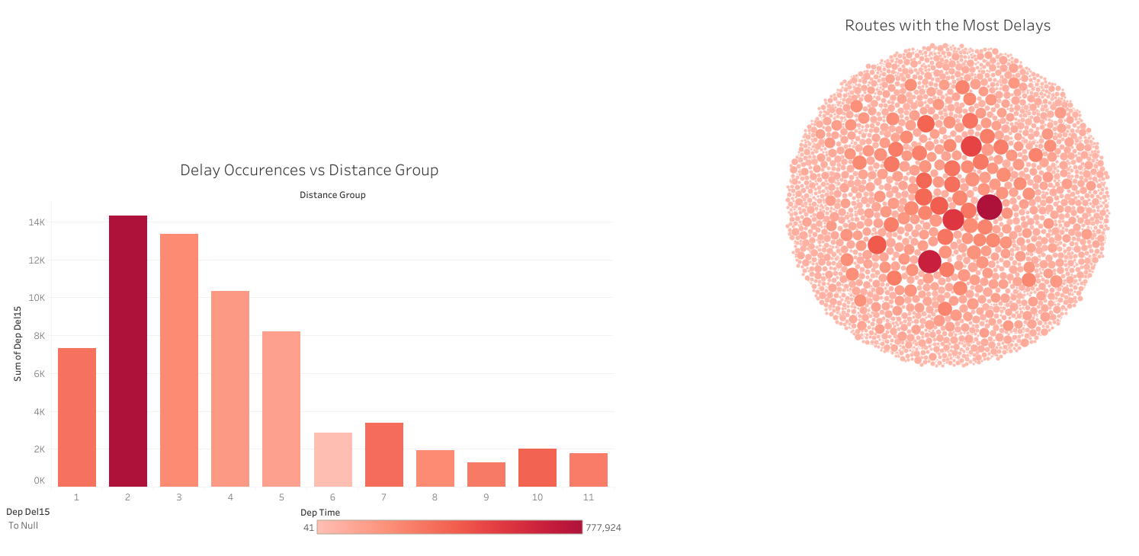

Flight Delays and Route Distances
Notes:
The 11 distance groups in the graph below represent different lengths of flight distance, with distance group 1 covering a distance of 0 - 250 km. Each consecutive group has an increased distance of 250 km
Distance group 2 (250 - 499 km) has the most occurrences of delayed flights followed by distance group 3. The longer distanced flights, beginning from distance group 6 (1250 km) to distance group 11 (4999 km), have the least amount delayed flights
Routes going in and out of New York, NY appear to face the most delays.
— Top 5 Routes with the most delays:
(1) Chicago, IL to New York, NY
(2) New York, NY to Chicago, IL
(3) Boston, MA to New York, NY
(4) Los Angeles, CA to San Francisco, CA
(5) San Francisco, CA to Los Angeles, CA

Slide 8

BOARDING PASS
Machine Learning Model
NOTE:
Supervised Learning
Logistic Regression Model
Balanced Random Forest Classifier
Easy Ensemble AdaBoost Classifier
Notes:
1) Create a model with LogisticRegression().
2) Train the model with model.fit().
3) Make predictions with model.predict().
4) Validate the model with accuracy_score().

Slide 9
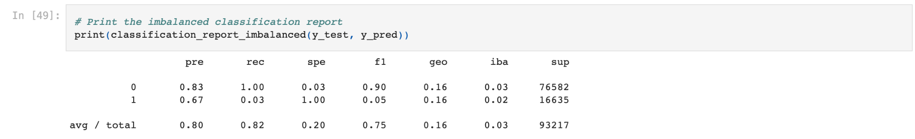
Machine Learning Log Regression (Logistic Regression Model)
Notes:
The Logistic Regression Model is used to predict whether a flight will be delayed or not based on various factors such as the day of the week, routing of the flight and weather conditions.
The accuracy score of the model is 82.4% which means the prediction power is decent.
The precision score for no delay (denoted by 0) is 83%. This means when the model predicts the flight will not delay, it is correct 83% of the time. The precision score for delay (denoted by 1) is 67%, which means the prediction power is not as good as no delay, but it is still decent.
The F1 score (harmonic mean) of the no delay and delay is 90% and 0.05%, respectively. This suggests the model handles prediction for no delay very well, but a different story for prediction for delay.
Compare to the ability to predict no delay, the ability to flag potential delay is more important. More data could be introduced in future to better train the Logistic Regression Model.

Slide 10
Constraints of the current model and planning for the future
CONSTRAINTS
PROPOSAL FOR THE FUTURE
Current Data set solely deals with the month of January. Given more time we would have included the full 12 months in the year.
1. Trying new datasets to include other routings, including international flights.
2. Test the Machine Learning model with other datasets.

